Slide 1


Lecture 2-8 Web Data Integration through Caching and Recommendation
CSE446 / CSE598 Software Integration and Engineering
Unit 2 Software Development by Composition and Integration
Text Sections 5.5 and 11.3.2
Dr. Yinong Chen

Slide 2
Roadmap:
Web Caching
We compute data or request data when we need certain data. Can web applications reuse/share the data if the data does not change, or has not changed?
What is Web Caching?
Why Web Caching?
Basic Web Caching Techniques
Advanced Caching: Web Data Caching
Implementation of Web Data Caching
Web Caching versus Recommendation System
Social Filtering and Recommendation
Legal and Ethics Issues in Caching and Recommendation

Slide 3
From Memory Caching to Web Caching
Rationale behind caching in computer architecture
Temporal locality: Data used are likely to be used again
Spatial Locality: Data used, and their neighboring data are likely to be used: Data like array are stored in block
Memory accesses are slow
Reasons for Web Caching
Web is a super large enterprise system, with a lot of computing, memory & disk accesses, and communications;
Data accesses to Web services and databases are slow & costly;
Most people want to know the same things, e.g., what other people are reading or buying;
A page could continue to exist after the original page becomes unavailable;
Supporting data mining and social filtering
Caching is also expensive: Carefully select caching data and tradeoff between performance gain and cost.

Slide 4
What are Google’s Major Innovations?

Slide 5

(1) Crawling
Web
User
Data
Query
Crawling
Search
Engine
Result
Searching
Result
Indexing
Index
K1
d1d2
Indexes: quick lookup tables
(like the index pages in a book)
K2
d1d3
…

Slide 6
(2) Distributed & Parallel Computing
Web-Based Distributed Software Development
1
2
Database
(copies of all
web pages!)
4
3
Front-end
web server
Content servers

Slide 7
(3) Indexing
Organize data in layers for fast accesses
1
2
3
Database
(copies of all
web pages!)
6
5
4
Front-end
web server
Index servers
Content servers
Protocol Buffers for efficient data representation and processing;
BigTable based on B+ tree for indexing

Slide 8
(4) Web Caching
Most people want to know the same things.
A page continues to exist after the original page is removed by the creator
CACHE
(copies of recent results)
1
Database
(copies of all
web pages!)
2
Front-end
web server
Index servers
Content servers
Notes:
Please explain the concept of “catching” (provide an example)

Slide 9
Types of Web Caching
Caching Type | Features
Output Caching | The entire xhtml (or html) page generated from aspx page is cached. When the same page is requested, the same rendered page is sent to the browser. Caching duration and location (on server or client side) can be specified. Text 5.5.1
Fragment Caching | Caching the entire page may be too expensive. Specifying a fragment of a page through a user control to cache partial data can be a better tradeoff between performance and cost. Text 5.5.2
Data Caching | Selecting individual data objects and organizing them for implementing cross-business logic; Define and program your own data objects for caching, with the support from the runtime environment for threading, placement, and replacement. Read text 5.5.3
Multi-layer Caching | Combine all caching techniques and apply them at all layers: output caching, fragment caching, data caching, and API/service caching

Slide 10
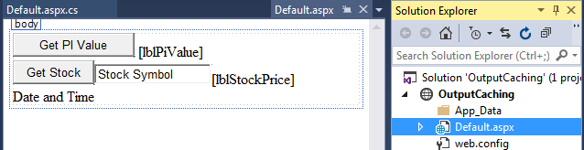
Output Caching: GUI Design
public partial class _Default : System.Web.UI.Page {
protected void Page_Load(object sender, EventArgs e) {
String date = DateTime.Now.ToLongDateString();
String time = DateTime.Now.ToLongTimeString();
lblDateTime.Text = date + ", " + time;
}
protected void btnStock_Click(object sender, EventArgs e) {
Random r = new Random(); int price = r.Next(100);
lblStockPrice.Text = Convert.ToString(price);
protected void btnPiValue_Click(object sender, EventArgs e) {
double pi = System.Math.PI;
lblPiValue.Text = Convert.ToString(pi);
}
}
Should not cache the time
Cache for a few seconds
Or call stock service in ASU WSR
Cache for a long time

Slide 11
Add One Line of Directive to Source Page
<%@ Page Language="C#" AutoEventWireup="true" CodeFile="Default.aspx.cs" Inherits="_Default" %>
<%@ OutputCache duration="10" varybyparam="None" %>
<!DOCTYPE html PUBLIC "-//W3C//DTD XHTML 1.0 Transitional//EN" "http://www.w3.org/TR/xhtml1/DTD/xhtml1-transitional.dtd">
<html xmlns="http://www.w3.org/1999/xhtml">
<head id="Head1" runat="server">
<title>Caching Page</title>
</head> <body> <form id="form1" runat="server">
<div>
<asp:Button ID="btnPiValue" runat="server" Text="Get PI Value" Width="133px"
onclick="btnPiValue_Click" /> &nbsp;
<asp:Label ID="lblPiValue" runat="server"></asp:Label>
</div>
<asp:Button ID="btnStock" runat="server" onclick="btnStock_Click"
Text="Get Stock" />
<asp:TextBox ID="txtAbsoluteValue" runat="server">Stock Symbol</asp:TextBox>
…

Slide 12
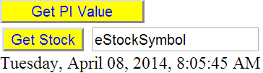
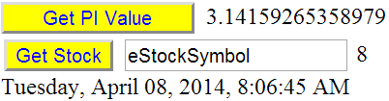
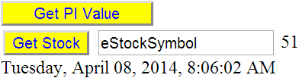

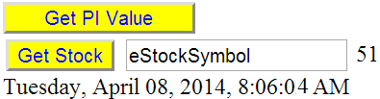
Testing of Caching
http://neptune.fulton.ad.asu.edu/WSRepository/OutputCaching/Default.aspx
Wait longer (> 10 seconds)
45
02
04
No value!
04
No change

Slide 13
Caching with Parameter Values
<%@ OutputCache duration="10" varybyparam="None" %>
Cache for 10 seconds
Cache one page for all users
varybyparam=“Book_Title”
varybyparam=“Book_Title; Author”
If parameter values are specified, different pages will be cached for different parameter values
Caching on client side
<%@ OutputCache duration="10" varybyparam=“partId" Location = "Client" %>
What are the pros and cons of client-side caching?

Slide 14
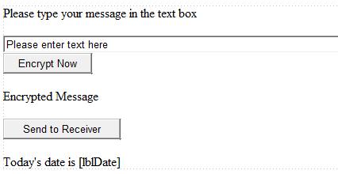
Fragment Caching through User Controls
Another reason of using user controls
A User Control in the ASPX page
Add this line in User Control
<%@ Control Language="C#" AutoEventWireup="true" CodeFile="DateToday.ascx.cs" Inherits="Confirmation" %>
<%@ OutputCache duration="10" varybyparam="None" %>
<asp:Label ID="lblConformMsg" runat="server" Text="Today's date is "></asp:Label>
<asp:Label ID="lblDate" runat="server" Text=""></asp:Label>

Slide 15
Web Data Caching
Selecting individual data objects and organizing for implementing unique business logic

Slide 16
Organization of Data Caching
Clients 1, 2, 3
Partner service
No worry of memory usage
Service
Web Data Caching
Web Application
Session 1
Service session
Service session
Cache
Web Application
Session 2
Service session
Main Memory
Service
. . .
Web Application
Session 3
Disk
Session
creation
Storage for Caching with placement and replacement policies
Database
Web Application

Slide 17
Use Application State for Data Caching?
You could save data objects into Application State and made them available to all sessions.
What is wrong with using Application State?
You have to be aware of how much memory you use;
You have to update the lists and dispose the older items and lists;
You have to manage the threads and lock the objects while you are updating them.
No

Slide 18
ASP .Net Caching Classes
ASP .Net provides a namespace of caching classes that automates the tasks necessary for caching, which allows one to
Use the same Application/Session State syntax: Cache[“indexkey”] = object.
Easy to use with a familiar syntax;
Automated Expirations — absolute or relative expirations for underused items to expire automatically.
Define dependencies between cached items and other items
Automated Callback — Event handler can be added that will be called when an item is to be removed from the Cache, giving us an opportunity to update the Cache or not remove the item.
Manage threads automatically to prevent conflicting.

Slide 19
Namespace: System.Web.Caching in FCL
Cache class: The class cannot be inherited. When an instance of the class Cache is created in a session, the instance will be
available to all sessions, like Application State, and
valid till the application is closed or the cache expires.
CacheDependency class:
Establish dependency relationship between an item/object and
a file or a database
a cache key,
an array of either,
or another CacheDependency object.
The CacheDependency class monitors the dependency relationships so that when a relation changes, the cached item will be automatically removed.

Slide 20
Namespace: System.Web.Caching in FCL
http://msdn.microsoft.com/en-us/library/system.web.caching
There are many other classes in the namespace, including:
AggregateCacheDependency
DatabaseNotEnabledForNotificationException
FileResponseElement
HeaderElement
MemoryResponseElement
OutputCache
OutputCacheProvider
OutputCacheProviderCollection
ResponseElement
SqlCacheDependency
SqlCacheDependencyAdmin
SubstitutionResponseElement
TableNotEnabledForNotificationException

Slide 21
Useful Methods in Cache Class
Add: Adds a specific item to an existing Cache object, such as dependencies, expiration, priority, and a delegate you can use to notify your application when the inserted item is removed from the Cache.
Remove: Removes the specified item from the application's Cache object.
Get: Retrieves the specified item from the Cache object.
GetType: Gets the Type of the current instance. (Inherited from Object)
ToString: Convert the current Object to a string. (Inherited from Object)

Slide 22
Overloaded Insert Methods in Cache Class
Insert(String, Object), or Cache[“indexkey”] = Object;
Insert(String, Object, CacheDependency)
Insert(String, Object, CacheDependency, DateTime, TimeSpan)
Insert(String, Object, CacheDependency, DateTime, TimeSpan, CacheItemUpdateCallback)
Insert(String, Object, CacheDependency, DateTime, TimeSpan, CacheItemPriority, CacheItemRemovedCallback)

Slide 23
Parameters of the Insert( ) Methods
Index key (string)
Item to be cached
Dependencies between the cached item and another item.
The cached item will be removed at the given date and time.
The cached item will be removed if the item is not accessed within the given time interval. If set to 0, only absolute expiration is used.
The cost of the object relative to other items stored in the cache.
A delegate that, if provided, will be called when an object is removed from the cache.
public void Insert(
string key,
Object item,
CacheDependency dependencies, DateTime absoluteExpiration, TimeSpan slidingExpiration, CacheItemPriority priority, CacheItemRemovedCallback
onRemoveCallback
)

Slide 24
CacheDependency Class
http://msdn.microsoft.com/en-us/library/system.web.caching.cachedependency
The class defines a parameter of the insert method of the Cache class;
Use null if no need to define the dependency.
It establishes a dependency relationship between the item stored in the Cache object and a file, a cache key, an array of either, or another CacheDependency object.
You can include dependency in Insert(), or add it later using Add().
The CacheDependency class monitors the dependency relationships so that when any of them changes, the cached item will be automatically removed

Slide 25
A simple example of using cache dependency, with one callback
protected void btnAddItem_Click(object sender, EventArgs e)
{ // create two cache items
string item1 = "Dell Printer 1710";
string item2 = "Cartridge for Printer 1710";
Cache.Insert("PrinterKey", item1, null, DateTime.Now.AddMinutes(10), TimeSpan.Zero, CacheItemPriority.Default, CacheRemovedCallBack);
Cache.Insert("CartridgeKey", item2, null, DateTime.Now.AddMinutes(20), TimeSpan.Zero); }
Dependency not defined here, but later
Delegate with Implicit
Parameter
Passing
Event handler
private void CacheRemovedCallBack(string IndexKey, object value,
CacheItemRemovedReason reason)
{ // remove the Cartridge from the cache if printer is removed
Cache.Remove("CartridgeKey");
}

Slide 26
Simple Cache Example: With Two Callbacks
protected void btnAddItem_Click(object sender, EventArgs e)
{ string item1 = "Dell Printer 1710";
string item2 = "Cartridge for Printer 1710";
Cache.Insert("PrinterKey", item1, null, DateTime.Now.AddMinutes(10), TimeSpan.Zero, CacheItemPriority.Default, CacheRemovedCallBack);
Cache.Insert("CartridgeKey", item2, null, DateTime.Now.AddMinutes(10), TimeSpan.Zero, CacheRemovedCallBack); }
Implicit
Parameter
Passing
private void CacheRemovedCallBack(string IndexKey, object value,
CacheItemRemovedReason reason)
{ // remove the Cartridge from the cache if printer is removed
if (IndexKey == "PrinterKey" )
Cache.Remove("CartridgeKey");
else if (IndexKey == "CartridgeKey")
Cache.Remove(“PrinterKey"); }
Shared event handler

Slide 27
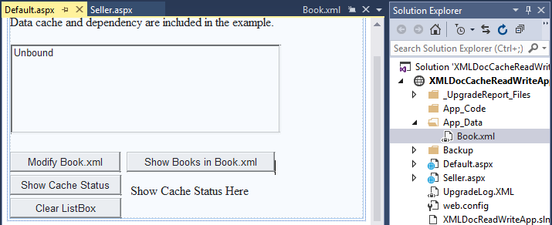
Bookstore Example
http://neptune.fulton.ad.asu.edu/WSRepository/XMLDocCacheReadWriteApp/Default.aspx
This is example is a revised version of the example used for demonstrating the XML and text file operations. The application consists a Default.aspx page and a Seller.aspx page.

Slide 28
Default.aspx: When page is loaded
protected void Page_Load(object sender, EventArgs e) {
if ((Cache["BooksKey"] != null) && (!ckBypassCache.Checked)) {
ListBox1.Items.Clear();
XmlDocument xd = (XmlDocument)Cache["BooksKey"];
XmlNode node = xd;
XmlNodeList children = node.ChildNodes;
foreach (XmlNode child in children.Item(1))
{
ListBox1.Items.Add(child.FirstChild.InnerText + " " + child.FirstChild.NextSibling.InnerText + " " + "$" + child.LastChild.InnerText);
}
}
if (Cache["BooksKey"] == null)
lblCacheStatus.Text = "No Cache of Book.xml";
else
lblCacheStatus.Text = Cache.ToString();
}
If there is data in cache, and cache is not bypassed
Load data from cache. Cache is in memory, not in disk!
Display cache data into ListBox
Display initial cache status

Slide 29
Code Behind Button
protected void btnShowCache_Click(object sender, EventArgs e)
{
ListBox1.Items.Clear();
if ((Cache["BooksKey"] != null) && (!ckBypassCache.Checked))
{
ListBox1.Items.Clear();
XmlDocument xd = (XmlDocument)Cache["BooksKey"];
XmlNode node = xd;
XmlNodeList children = node.ChildNodes;
foreach (XmlNode child in children.Item(1))
{
ListBox1.Items.Add(child.FirstChild.InnerText + " " + child.FirstChild.NextSibling.InnerText + " " + "$" + child.LastChild.InnerText);
}
}
}
The code is similar to the code behind Page_Load

Slide 30
Code Behind the Button
protected void btbReloadFile_Click(object sender, EventArgs e) {
FileStream fS = null; string fLocation = Path.Combine(Request.PhysicalApplicationPath, @"App_Data\Book.xml");
try { if (File.Exists(fLocation)) {
fS = new FileStream(fLocation, FileMode.Open, FileAccess.Read);
XmlDocument xd = new XmlDocument(); xd.Load(fS);
fS.Close(); // close after loading
if (Cache["BooksKey"] == null) { // It was removed when file is changed
CacheDependency fileDependency = new CacheDependency(fLocation);
Cache.Insert("BooksKey", xd, fileDependency, DateTime.Now.AddMinutes(30), TimeSpan.Zero, CacheItemPriority.Default,
new CacheItemRemovedCallback(CacheRemovedCallBack));
XmlNode node = xd;
XmlNodeList children = node.ChildNodes;
foreach (XmlNode child in children.Item(1)) {
ListBox1.Items.Add(child.FirstChild.InnerText + " " + child.FirstChild.NextSibling.InnerText + " " + "$" + child.LastChild.InnerText);}}}}
finally { fS.Close(); }} // close in case the session crashes
Add data into cache and define the dependency to the file & callback

Slide 31
Define the Callback Handler
private void CacheRemovedCallBack(string IndexKey, object value,
CacheItemRemovedReason reason)
{ // remove the cache if the file is changed
if (IndexKey == "BooksKey")
Cache.Remove("BooksKey");
}
protected void btnShowCache_Click(object sender, EventArgs e)
{
if (Cache["BooksKey"] == null)
lblCacheStatus.Text = "No Cache of Book.xml";
else lblCacheStatus.Text = Cache.ToString();
}
protected void btnClear_Click(object sender, EventArgs e) { // Clear ListBox
ListBox1.Items.Clear();
ListBox1.Items.Add("The ListBox is cleared... ");
}
}
Callback event handler
Remove the key from Cache
Read Text Section 5.5.2

Slide 32
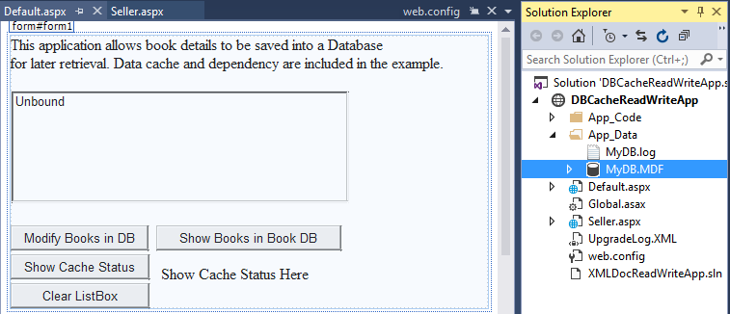
Bookstore Example: Saving to Database
This is example saves the books detail to a SQL database, instead of in a XML file.

Slide 33
Code Behind the Default.aspx (DB)
List<Book> objCache = (List<Book>)System.Web.HttpRuntime.Cache.Get("BooksKey");
itemRemoved = false;
onRemove = new CacheItemRemovedCallback(this.RemovedCallback);
if (objCache == null) {
DBContextDataContextDataContext myDB = new DBContextDataContextDataContext();
IQueryable<Book> q = from b in myDB.Books select b;
ListBox1.Items.Clear();
foreach (Book child in q) {
ListBox1.Items.Add(child.Title + " " + child.Isbn + " " + "$" + child.Price);
}
objCache = q.ToList<Book>();
SqlCacheDependency dependency = new SqlCacheDependency(myDB.GetCommand(q) as SqlCommand);
HttpContext.Current.Cache.Add("BooksKey", objCache, dependency, DateTime.MaxValue, TimeSpan.Zero, CacheItemPriority.Default, new CacheItemRemovedCallback(onRemove)); }
Read data from DB and place into myDB
Query the object
Define dependency and add data into cache

Slide 34
Code Behind the Seller.aspx, Submit Books (DB)
string title2 = txtTitle2.Text; // Book 2 info
string isbn2 = txtIsbn2.Text;
string sPrice2 = txtPrice2.Text;
Book book2 = new Book();
book2.Title = title2;
book2.Isbn = isbn2;
book2.Price = float.Parse(sPrice2);
myDB.Books.InsertOnSubmit(book2); // Save into book object
string title3 = txtTitle3.Text; // Book 3 info
string isbn3 = txtIsbn3.Text;
string sPrice3 = txtPrice3.Text;
Book book3 = new Book();
book3.Title = title3;
book3.Isbn = isbn3;
book3.Price = float.Parse(sPrice3);
myDB.Books.InsertOnSubmit(book3); // Save into book object
myDB.SubmitChanges(); // Submit the all changes to DB
Cache.Remove("BooksKey"); // force removing cache
Submit into object
Submit into object
Submit into SQL database

Slide 35
What Data to Cache? It is a part of your business logic!
Data caching is useful not only for quick response time, but also for many other purposes, such as recommendation;
Manufacture recommendation: For each product, the manufacture suggests a list of accessories:
The list is static and easy to maintain, no caching required
“Most Frequently Bought (MFB)” items to inspire customers to buy popular items;
“Frequently Bought Together (FBT)” items: For each product a customer is viewing, show the list of FBT.
The list is dynamic and will be update frequently
Using social networking/collaborative model

Slide 36
Caching vs. Recommendation
Many websites generate a recommendation list, which ranks a set of available choices based on certain given criteria and available set of inputs;
Caching buffers the recently accessed information;
They are different techniques, but they support each other:
Caching provides recently accessed information, which can be used as a criterion and as an input to the recommendation;
Recommendation system generates important information, which can be used as a replacement policy for caching.

Slide 37
What is a Recommendation System? Text Section 11.3.2
A recommendation system is a subclass of information filtering system that predicts the rating, ranking, and preference, which a user would give to an item, or the probability that a user would buy the item.
Many websites generate a recommendation list for a user when the user is viewing an item, which shows the available choices of alternatives or complementary items based on certain criteria and available set of inputs.
The goal of recommendation is to increase the sale.

Slide 38
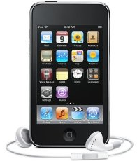
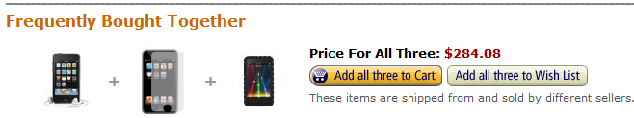
Recommendation in Amazon.com
www.amazon.com
How do you implement the “Frequently Bought Together” List?
Apple iPod touch
32 GB
$268.84
This item: Apple iPod touch 32 GB (3rd Generation) NEWEST MODEL
iKross 3-Pack Premium Reusable LCD Screen Protector with Lint Cleaning Cloth for iPod touch 1G (Clear)
Speck PixelSkin Rubberized Case for iPod touch 2G, 3G (Black)

Slide 39
Simple Implementation Idea of the Frequently Bought Together Items
Product Class
String ProductName
It is a priority list, sorted by the fbtRate!
Product properties
methods
void updateFBTList()
FBT fbtRef
FBT Class
String ProductName
String ProductName
String ProductName
Product productRef
Double fbtRate
FBT fbtRef
Product productRef
Double fbtRate
FBT fbtRef
Product productRef
Double fbtRate
FBT fbtRef

Slide 40
Search Engine vs. Recommendation System
Most criteria for a recommendation system also apply to a search engine. The main differences are
Both generate a ranked list of information based on user input:
Search engine’s input is explicit.
Recommendation system’s input is implicit.
Both try to generate the most relevant list to users
Search engine generates hot spot information + sponsored list
Recommendation system tries to avoid hot spot items, which can bring more benefit to the business.
Information Sources:
Search engine uses public information mostly.
Recommendation system can use the internal database such as user profiles

Slide 41
Strategies of Recommendation
Social filtering or collaborative filtering
Use the behaviors and preferences of collective users on the concerned items as the basis of recommendation;
Content-based filtering
Use the attributes and semantics of the concerned items to recommend similar items;
User profile filtering
Based on the age, gender, the historical behavior (past shopping list) of the user, etc., to recommend;
Situation-aware filtering
Based on availability of the items, promotional information of the items, etc., to recommend.

Slide 42
Collaborative Filtering Spectrum
Collaborative Filtering (CF) Algorithms
Live data collected
Model-based
Memory-based
Machine-Learning
Training →Model
Model-based
Memory-based
Model improvement
Math models based on past and current data
User-based
Item-based
Ranking-oriented CF
(order in ranking)
Rating-oriented CF
(the numeric value)

Slide 43
Collaborative Filtering (CF)
Main idea of CF is to group users into neighborhoods based on their product preferences and review scores
Model-based CF uses a mathematical, statistical, or learning model to analyze data and make predictions.
User-based CF estimates the unknown ratings of a target user based on the ratings given by neighboring users.
Item-based CF algorithms, item-item similarities are used to select a set of neighboring items that have been rated by the target user.

Slide 44
User-Score Matrix
1 2 3 . . . j n-1 n
n items
1
2
.
.
.
i
R_{mx n}
All scores given by user i. The users’ preferences on all items are the basis of item-based CF.
m-1
m
The scores of item j given by all users. If 2 users give the similar scores to the same items, they have the same “taste”, which is the basis of user-based CF.
m users
The score of item j given by user i

Slide 45
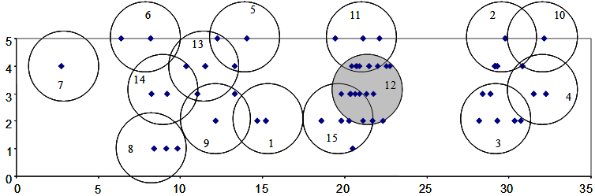
Rating-Oriented vs. Ranking-Oriented
Both rating-oriented CF and ranking-oriented CF can be applied to memory-based or model-based.
Rating-oriented CF algorithms group the users based on users’ historical rating scores on the items they review. If they give similar rating scores to the same items, they are considered neighbors in their judgment or taste.
The ranking-oriented CF algorithms group the users based on the ranking order of items that they review, which ignores particular values of rating scores but maintains the ordered preference relationships between the items.

Slide 46
Criteria of Good Recommendation
Accuracy represents the rate of relevancy between recommendation results and actual content, resulting in a high purchase rate.
Diversity refers to a reasonable extension to the content the user is accessing.
Non-Hot spot Coverage: This criterion has been generally admitted as a critical one. The recommendation should avoid hot topic data, which can bring more benefit to the site.
No “Cool Start”: Cool start is a situation when the system cannot make a recommendation, as it has not gathered sufficient information yet. Social filtering can suffer from cool start.
Performance: A system must provide real-time recommendation with live interaction with users.

Slide 47
Example: Situation Aware Mobile Recommendation
A typical scenario at Costco store: People hold their coupon books to search the items in store.
Installing a mobile “app” on your smart phone, with the support from Costco backend Web application:
Pop up the item in the coupon book as you are near the location of the item;
Recommend the items you need to buy, based on the information what you bought before and how frequent you buy the items before, for example, your water filter.
Recommend the best-sold items in the last 7 days
Recommend the most valuable item to buy (non-hot spot)
URL-based recommendation: read the URL history, analyse the items in the URL sites and recommend similar items.

Slide 48
Legal and Ethics Issues in Caching/Recommendation
Technologies are making more and more information available.
Balance between information privacy and openness
Developers need to be aware of legal and ethics issues in data caching. For examples
ASU has the organizational access to IEEE digital library (publications). Caching data and making them available to non-ASU users would violate the copyright law.
It is illegal to cache illegal data. It is the responsibility of the business and developer to detect and recognize illegal data.

Slide 49
Legal and Ethics Issues in Caching/Recommendation
Developers need to be aware of legal and ethics issues in recommendation. For examples
Is it ethical to use user’s profile or URL history to make recommendation?
Is it legal or ethical to explore personal emails and social networking sites, and phone conversations to make recommendation?
Individual sources are open/public information, should the combination and integration of the sources still be open/public?

